Slide 1

Smart Garbage Management System
Review-1
Sathish Srinivas 1KS15CS089
Shashwath GM 1KS15CS092
Shravya MS 1KS15CS096
Spandana Manjunath 1KS15CS103
Guide Name :- Mrs. Ashwini
Batch No. :- 2018_CSE_08
Group No. :- G2

Slide 2
Contents
Problem Statement
Objective
Methodology
Technology Used
Circuit diagram with Code
Testing and Result
Snapshots
References

Slide 3
Problem Statement
Waste management is the most discussed topic nowadays. Uncontrollable waste dumping has become a big threat to the cleanliness of the environment and health of the people living around.
Nowadays there are different categories of waste like organic, inorganic, electronic wastes etc. Hence effective waste management has become very important to improve the living standards for now and for future generation too.

Slide 4
Objective
The main objective of our proposed system is to create a device that can monitor the working of the Dustbin, and can alert the Waste Picker (sanitation worker) through a GSM message, to have an on time pickup that can help in improving a healthy ecosystem.
Why GSM ?
. Faster Way to get notified
. Doesn't require any smart phone
. Less Complex compared to an Mobile Application
. Doesn't Require Internet
. Reaches to the Sanitation worker's on time

Slide 5
METHODOLOGY
The Bin with Ultrasonic sensor, uses ultrasonic waves to check the level of the bin.
The bin will indicate its status to the end users through the blue led and red led installed on the system. Here blue indicates “space available, garbage can be dumped” and red indicates “Bin is Full”. The bin remains closed until the garbage is collected.
The bin is later emptied by the collector and the status of the bin returns back to “space available”. This helps in easy monitoring of the bin.

Slide 6
Technologies Used
Hardware Implementation
Arduino Uno R3
HC SR04(Ultrasonic Sensor)
Jumper wire’s (Male to Male, Female to Male, Female to Female)
LED
GSM Module
Software Implementation
C program

Slide 7
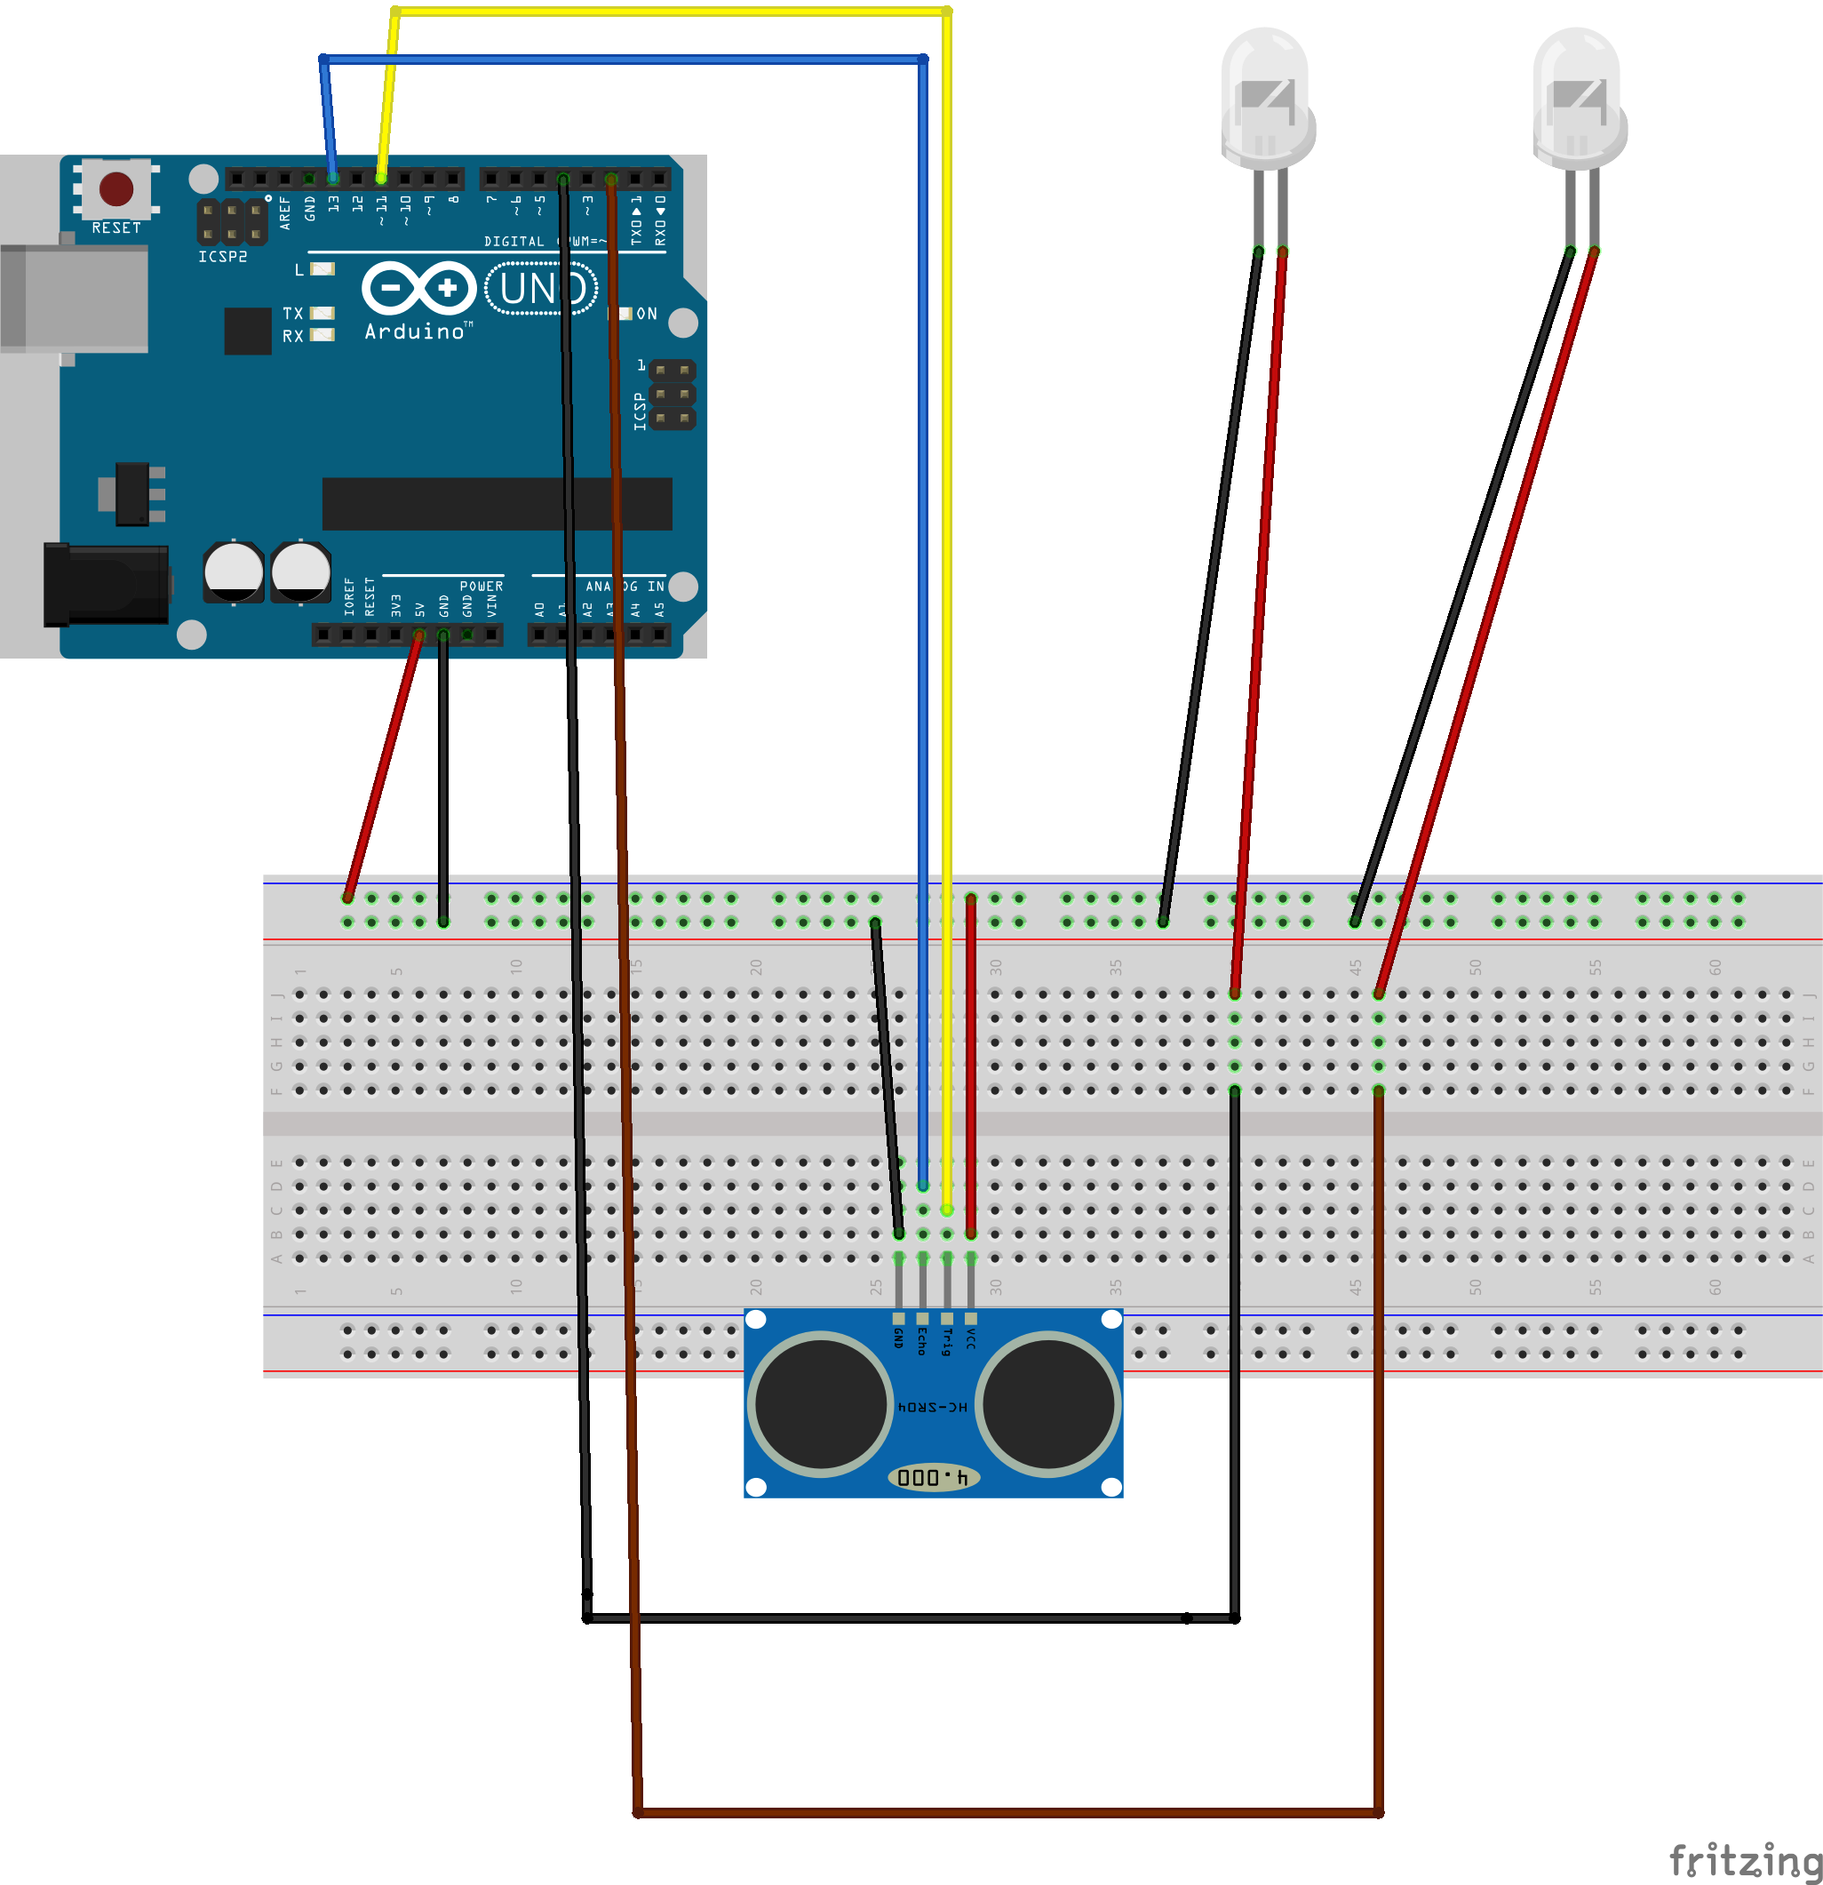
Circuit Diagram and Code
RED
BLUE
The Circuit is being designed using the software called Fritzing
The Circuit uses a Arduino Uno R3 module, HC SR04(Ultrasonic Sensor), Jumper Wire’s and LED
The circuit is being achieved as shown in the Figure.
Connection of Arduino board to ultrasonic sensor

Slide 8
CODE
#include <SoftwareSerial.h>
SoftwareSerial mySerial(9,10);
int ledBlue=2;
int ledRed=4;
int trigPin=13;
int echoPin=11;
float pingTime;
float distance;
float v=34600;

Slide 9
void setup()
{
Serial.begin(9600);
pinMode(trigPin,OUTPUT);
pinMode(echoPin,INPUT);
pinMode(ledBlue,OUTPUT);
pinMode(ledRed,OUTPUT);
mySerial.begin(9600);
delay(100);
}

Slide 10
void loop() { digitalWrite(trigPin,LOW); delay(2); digitalWrite(trigPin,HIGH); delayMicroseconds(15); digitalWrite(trigPin,LOW); pingTime=pulseIn(echoPin,HIGH); pingTime=pingTime/1000000.0; distance=v*pingTime; distance=distance/2.0; Serial.println("Distance to the target is:"); Serial.println(distance); distance=distance/2.0; Serial.println("Distance to the target is:");
9

Slide 11
Serial.println(distance);
if(distance>5)
{
digitalWrite(ledGreen, HIGH);
digitalWrite(ledRed,LOW);
}
else
{
if(mySerial.available()>0)
Serial.write(mySerial.read());
digitalWrite(ledBlue,HIGH);
digitalWrite(ledGreen,LOW);
}
}

Slide 12
Testing and Results
When there is an empty dustbin , the distance sensed by the HC SR04 is maximum so the blue LED glows (Which indicates that the dustbin is Empty)
When there is a full dustbin ,the distance sensed by the HC SR04 is minimum so the red LED glows (Which indicates that the dustbin is Full)

Slide 13
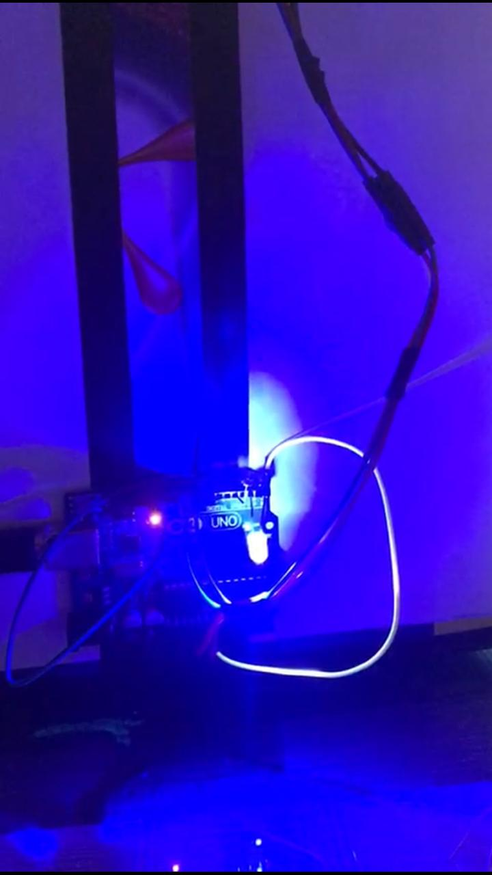
Snapshots
Fig: Bulb glowing blue when the dustbin is empty

Slide 14
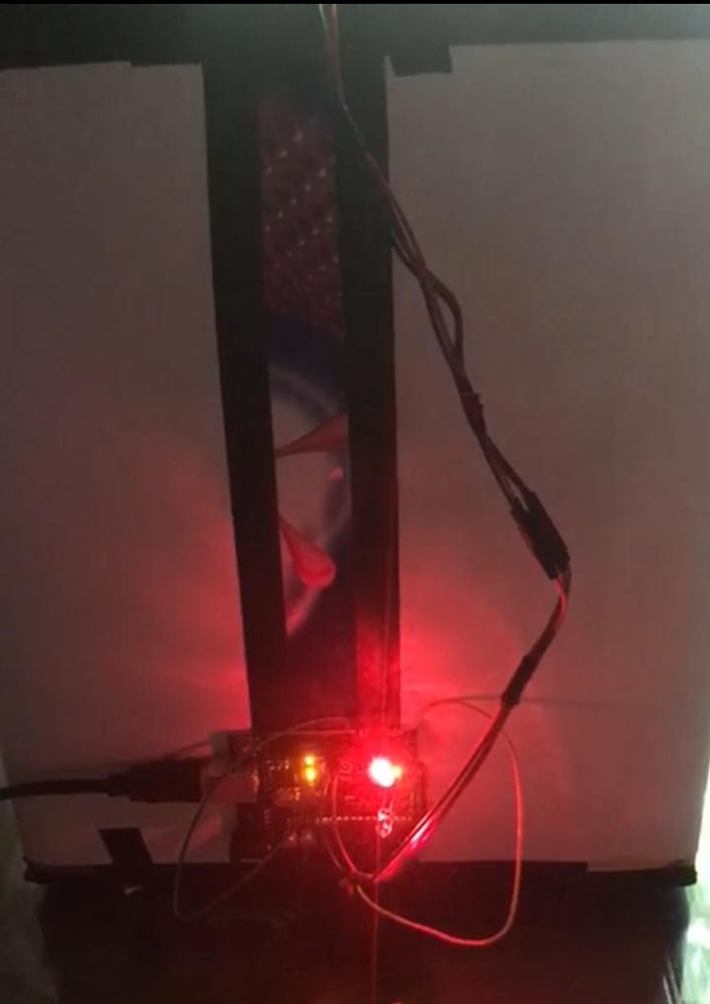
Fig: Bulb glowing red when the dustbin is full.

Slide 15
References
DataSheet of Arduino Uno R3 https://www.farnell.com/datasheets/1682209.pdf
Ultrasonic Sensor HC-SR04 and Arduino Tutorial https://howtomechatronics.com/tutorials/arduino/ultrasonic-sensor-hc-sr04/
Mr. Himadri Nath Saha, Mr. Supratim Auddy “Waste Management using Internet of Things (IoT) “, IEEE, 2017
Arduino Built in Code Examples https://www.arduino.cc/en/Tutorial/BuiltInExamples

Slide 16
Thank You

